Slide 1
Optimizing Allocations for Long-Term Sustainability
June
2025
Albert Chui, Aarti Garaye, Moira Keating, Jack Trujillo
Please note that all information shown is based on assumptions and simulated data created using an economic scenario generator.

Slide 2
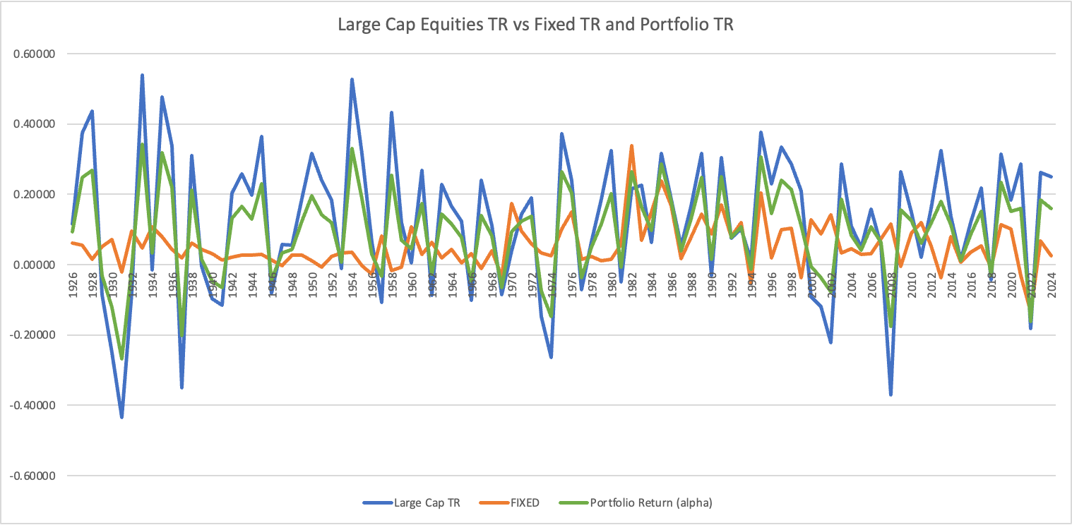
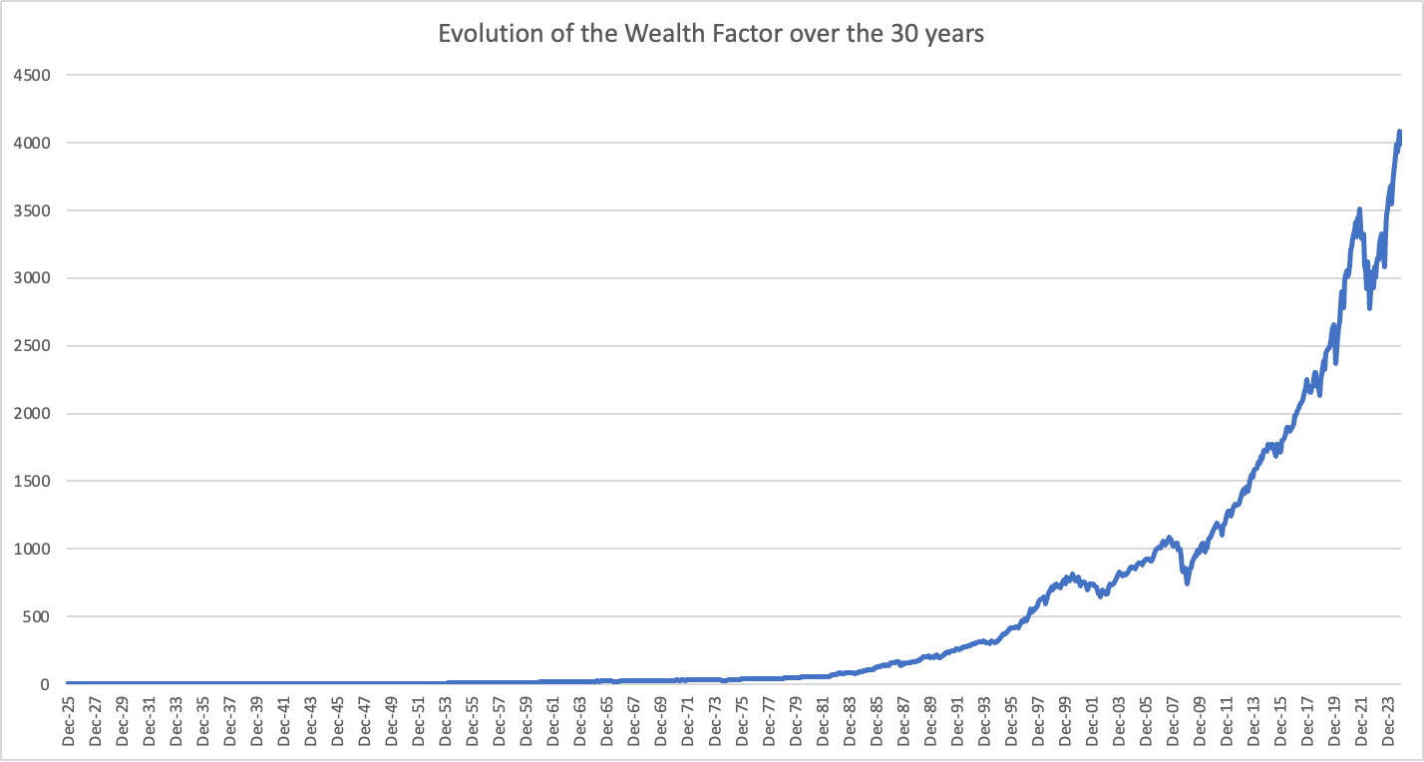
Managing a Legacy Portfolio
June
2025
We are tasked with the goal of recommending a 30-year investment allocation that preserves the purchasing power of the trust while continuing to support its annual 3% spending mandate.
The trust has followed a 60/40 approach
60% in US large cap equities
40% in a blended fixed income securities
65% in intermediate-term US treasury bonds
35% in long term corporate bonds
Exhibited more volatility in recent years
Annual inflation of 2.5%
Number of Years Portfolio return was higher than 5.5% | Percentage of Years that exceeded the 5.5% hurdle
64 | 0.646464646
Notes:
Aarti

Slide 3
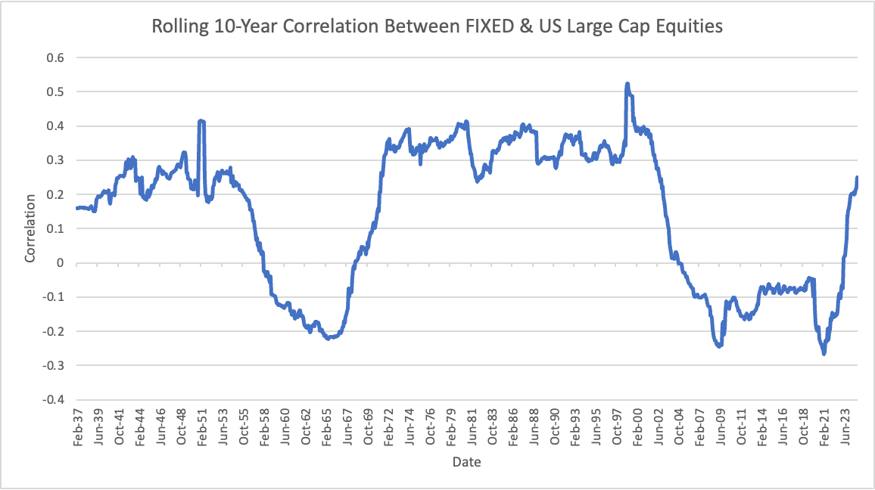
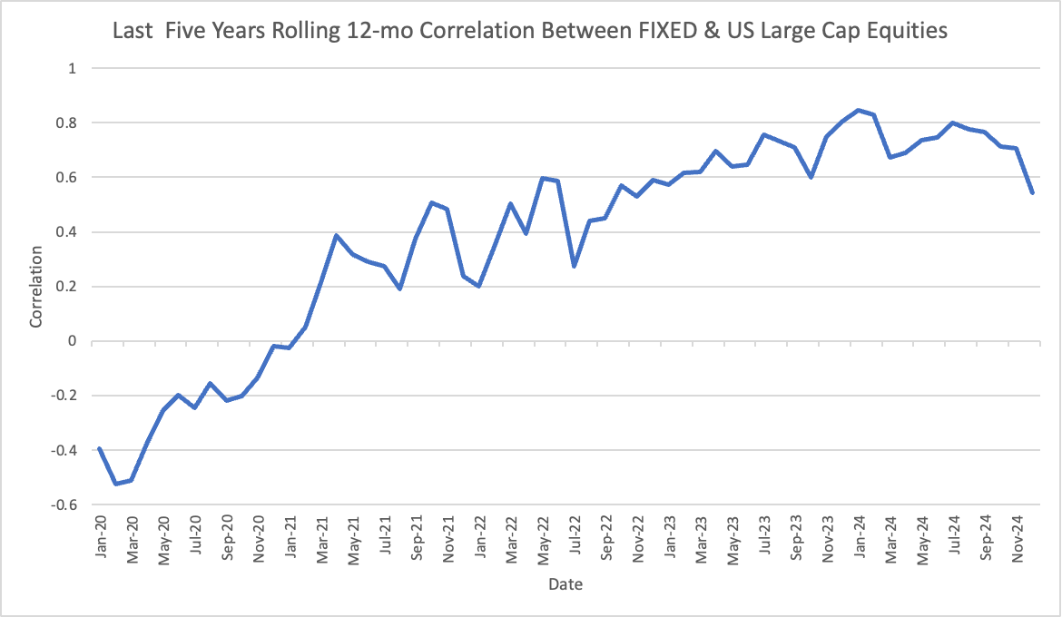
60/40 Historical Data
June
2025
The 60/40 approach has its pros and cons.
Pros:
Lower volatility, particularly during periods of negative correlation.
Moderate risk - works well for a fund seeking both growth and capital preservation.
Cons:
Interest rate sensitivity - bond durations decline when interest rates rise.
Inflation risk.
Exposure to corporate credit risk.
Less effective in low-yield environments.
High correlation between fixed income and equities in 2022 was a key factor in the fund’s poor performance, however such rapid increases are rare.

Slide 4
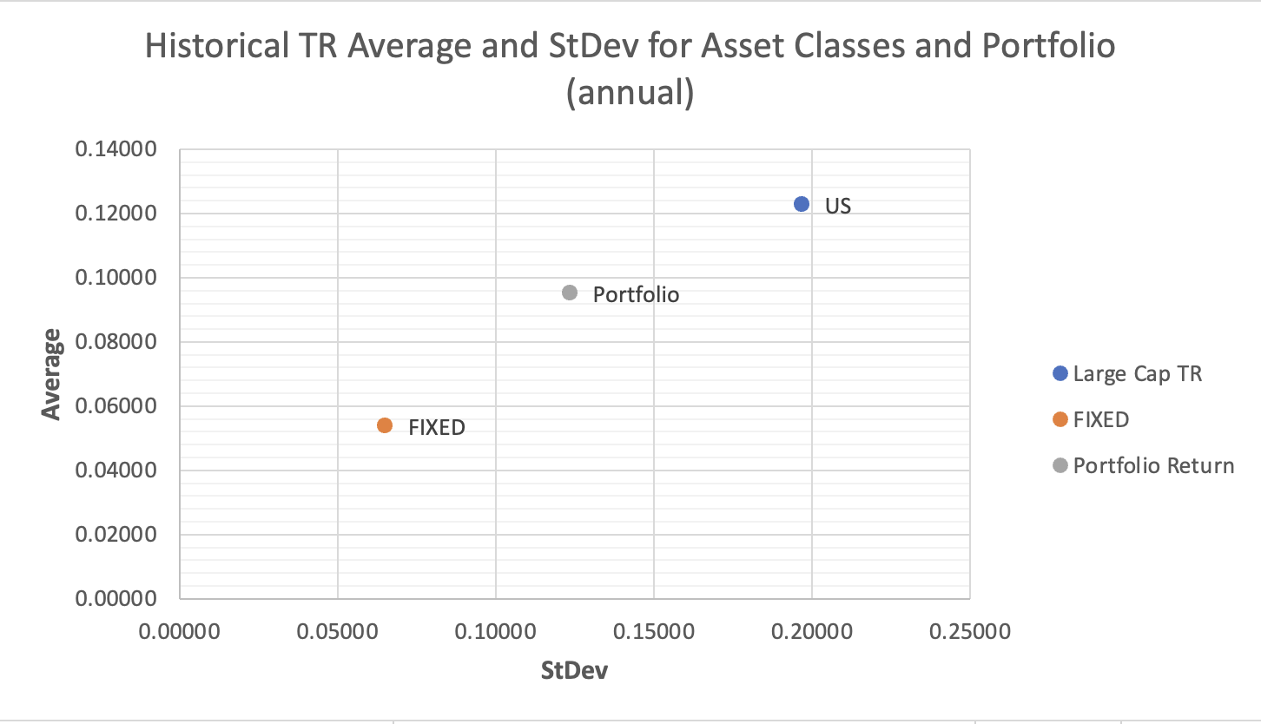
60/40 Historical Data
June
2025
Positive Correlation between average returns and volatility
60/40 strategy balances the volatility risk from equities and stability from fixed income
Reduces our risk without sacrificing all return
60/40 Benchmark Values
Probability of losing PP | Volatility | Average total returns | Median Real Return
18.1% | 10.7% | 0.07797 | 0.0177
Correlation | US Large Cap Equities | Fixed Income | 60/40 Portfolio
US Large Cap Equities | 1 | 0.098534 | 0.97736
Fixed Income | 0.098534 | 1 | 0.30516
Portfolio | 0.97736 | 0.30516 | 1
Correlation between equities and fixed income nearly zero
Diversification benefit
Preserving purchasing power while limiting volatility
Notes:
Moira

Slide 5
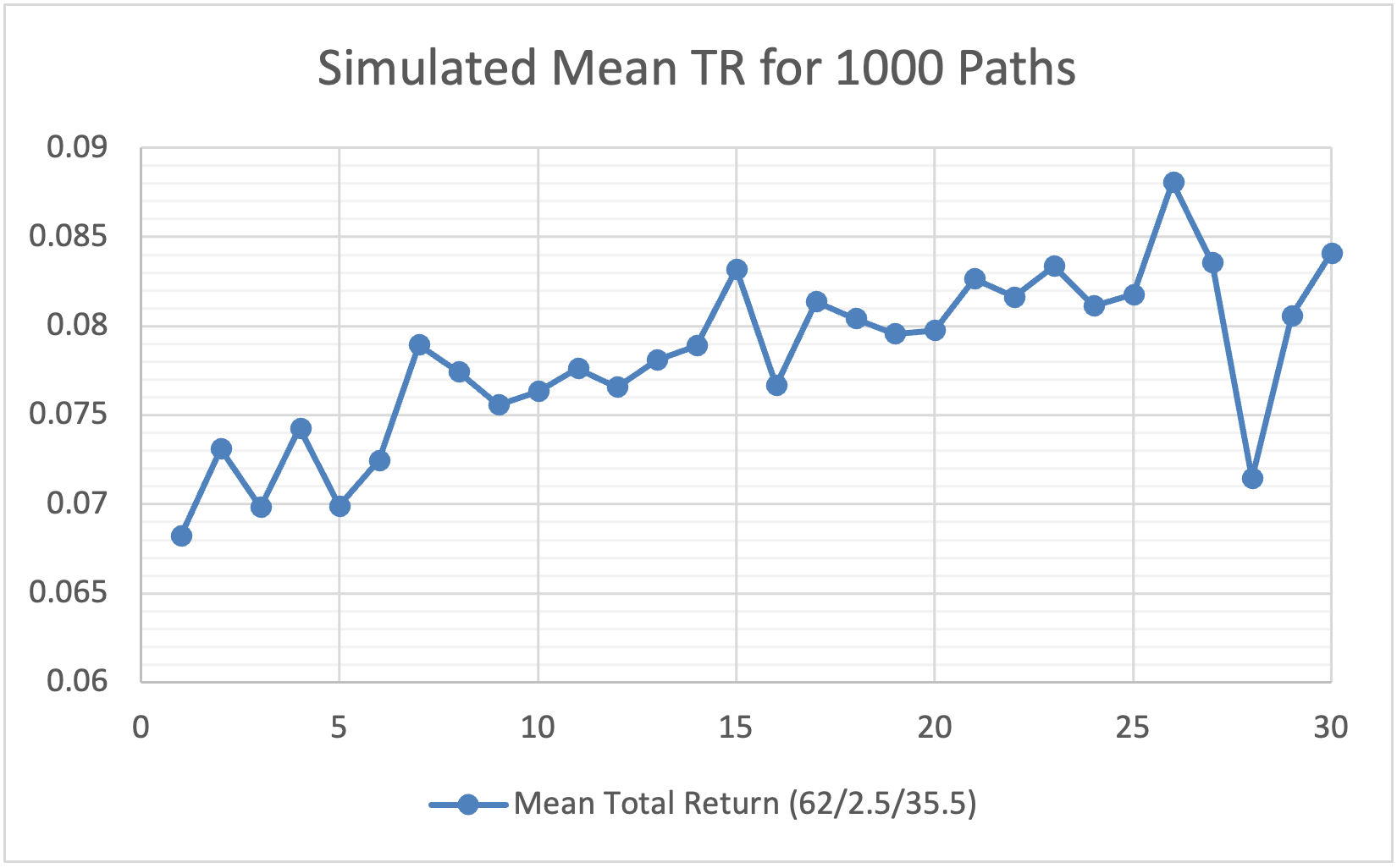
62/2.5/35.5 Allocation
June
2025
Probability of Loss of Purchasing Power | 17.8%
E[% Loss PP | Loss PP] | -26.43%
Real Balance ≥ 100 (Real Returns ≥ 0%) | 822
Real Balance Range | [25.54, 911.96]
Average Real Return | 1.73%
Median Real Return | 1.77%
Volatility | 10.88%
62% US Large Cap Equities, 2.5% Money Market, 35.5% Fixed Income Fund
Trade-off for lower probability loss of purchasing power for ~ 0.1% increase in volatility
Slight worsening in our conditional expectation approximately 1%
Increasing the weight in equity, results in capital growth of the fund.
A little less in fixed income securities results in less steady income.
Higher mean and median balance.
822 paths out of 1000 show positive real geometric return.

Slide 6
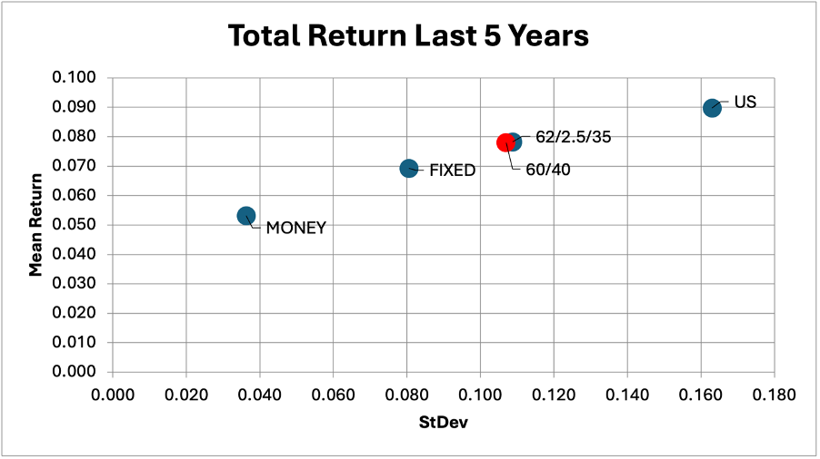
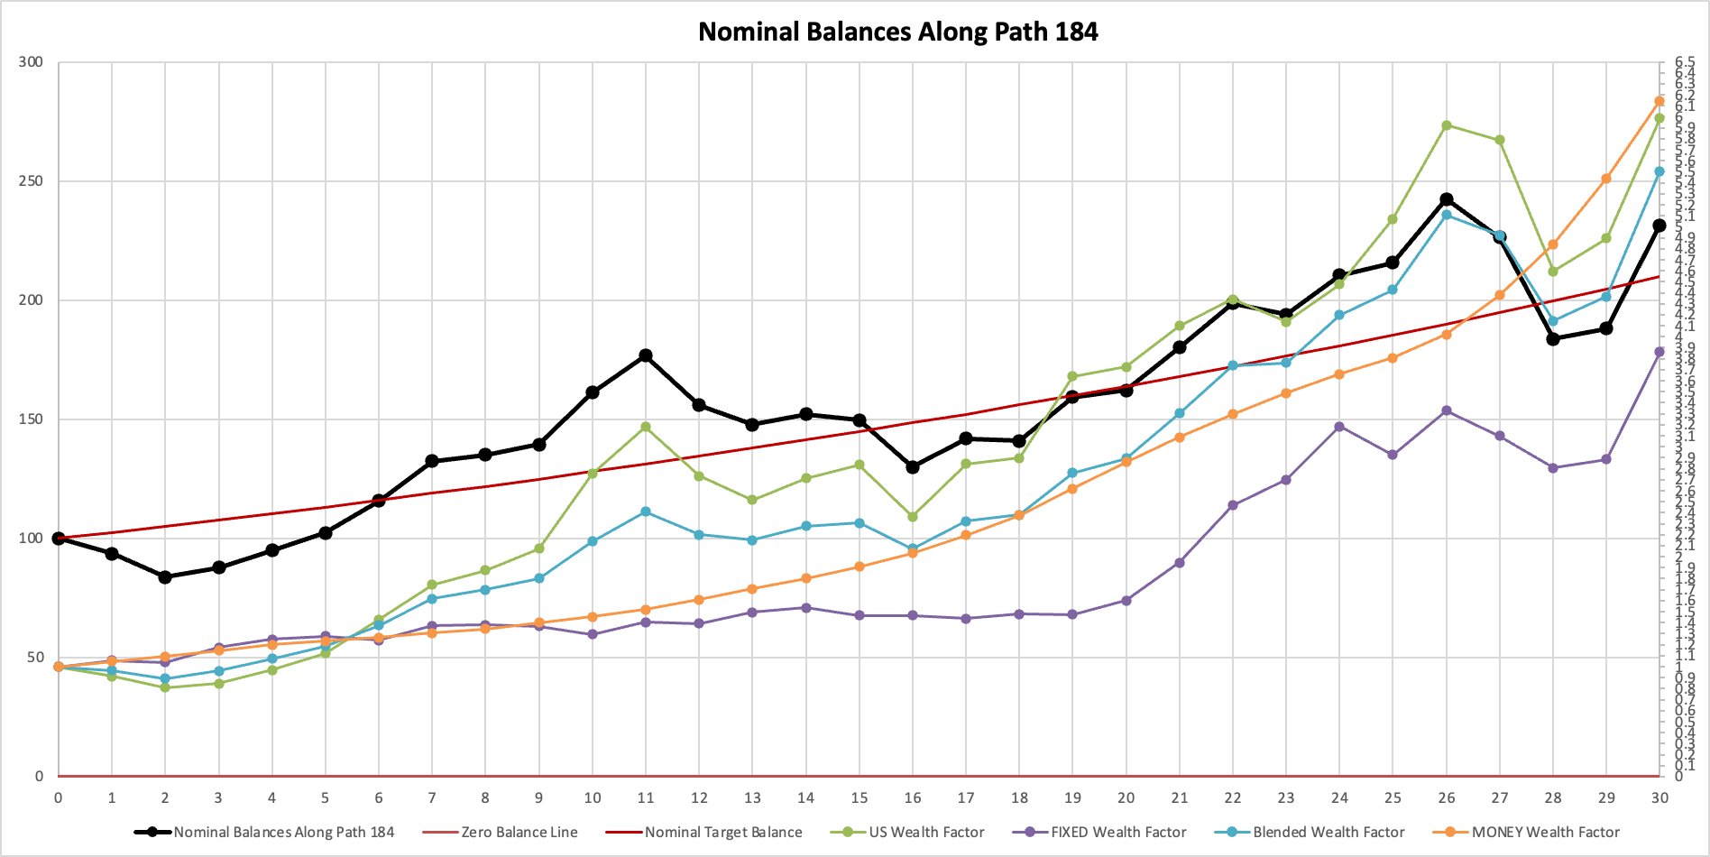
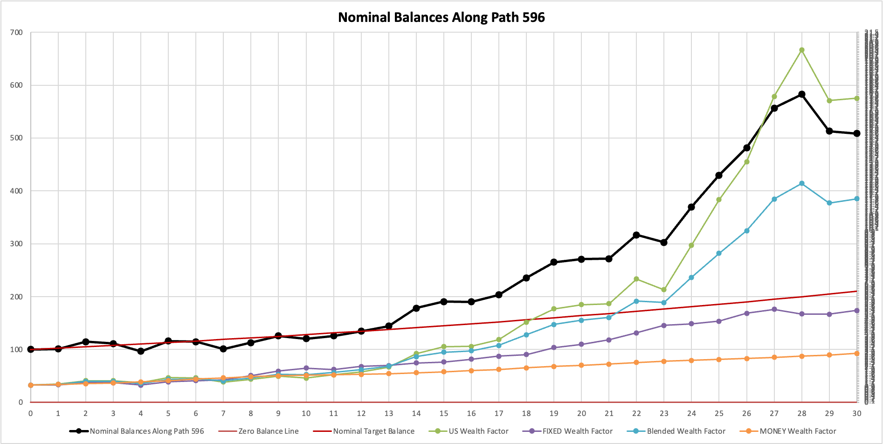
62/2.5/35.5 Allocation
June
2025
Slightly higher volatility but higher returns
Preserves purchasing power
In fact, reduces the probability of losing purchasing power compared to the 60/40.
25th percentile and 75th percentile are generating positive returns.
Paths tend to be above the nominal target balance.
25th percentile was path 184
75th percentile was path 596
Notes:
Aarti

Slide 7
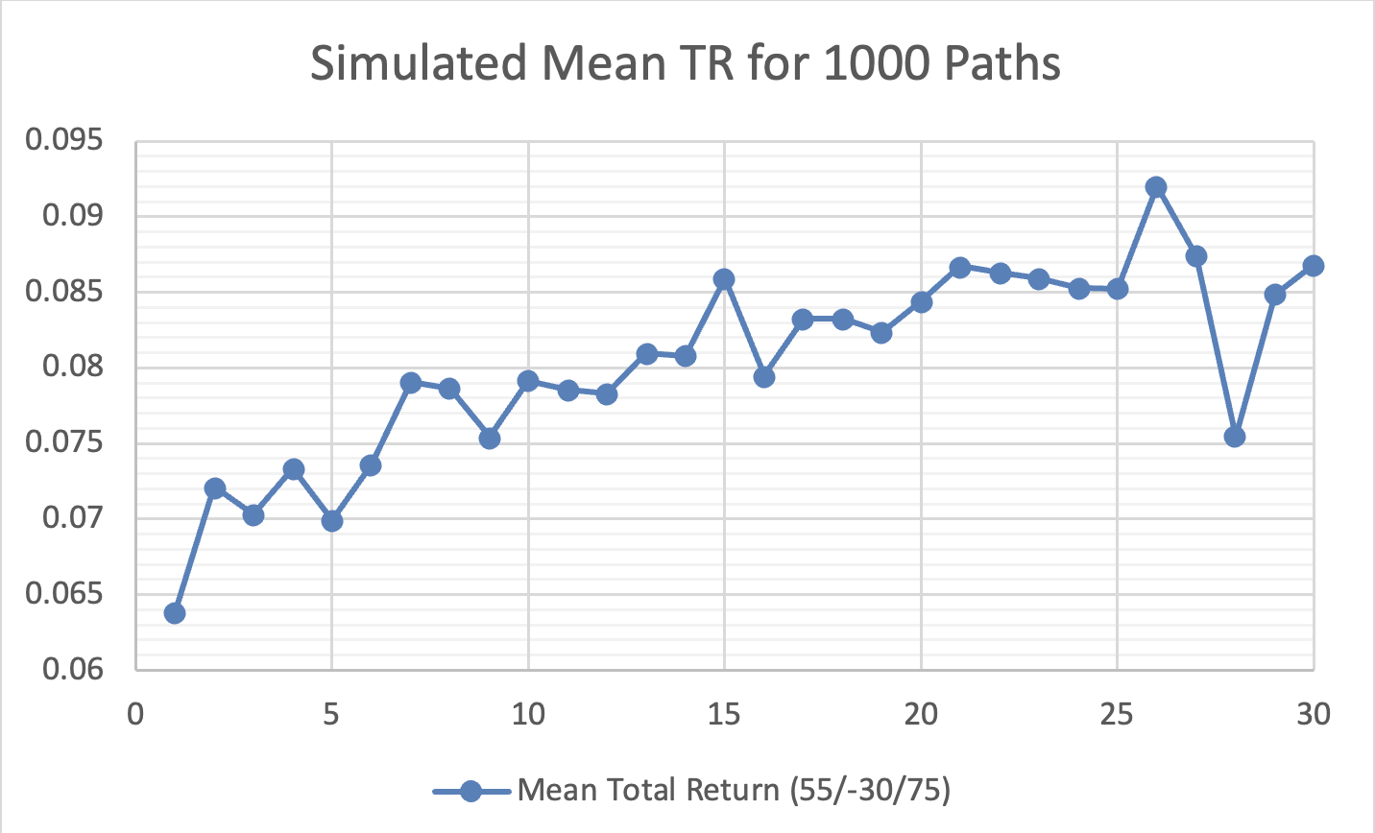
55/-30/75 Allocation
June
2025
Probability of Loss of Purchasing Power | 15.8%
E[% Loss PP | Loss PP] | -25.79%
Real Balance ≥ 100 (Real Returns ≥ 0%) | 842
Real Balance Range | [27.45, 1140.93]
Average Real Return | 1.90%
Median Real Return | 1.89%
Volatility | 11.27%
55% US Large Cap Equities, –30% Money Market, 75% Fixed Income Fund
Main difference is that we now must borrow money
Putting a significant amount of weight into Fixed Income
Trade-off for lower probability loss of purchasing power for ~ 0.6% increase in volatility
Slight worsening in our conditional expectation compared to current allocation by < 1%
Higher average and median return
Notes:
Moira

Slide 8
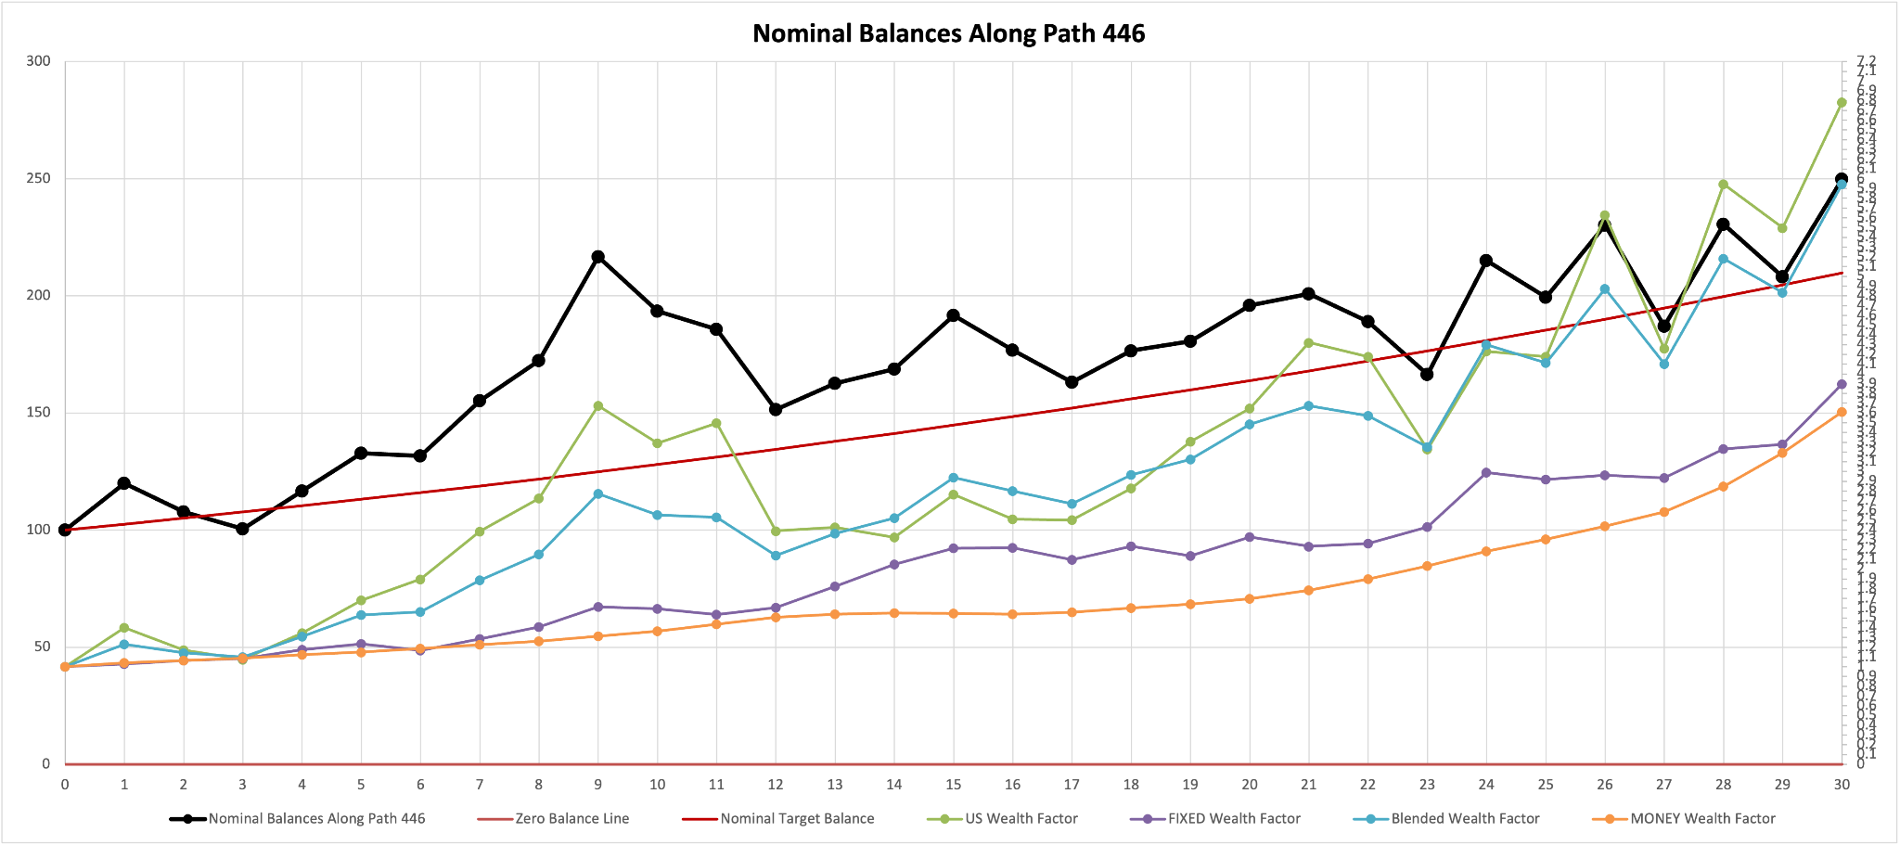
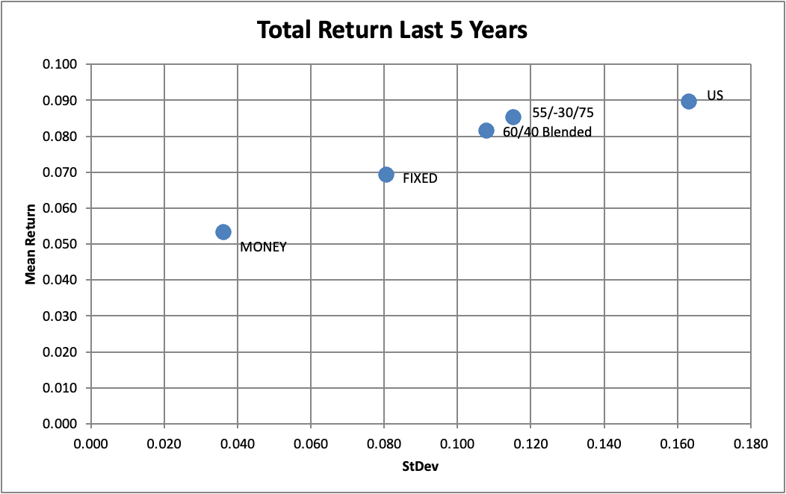
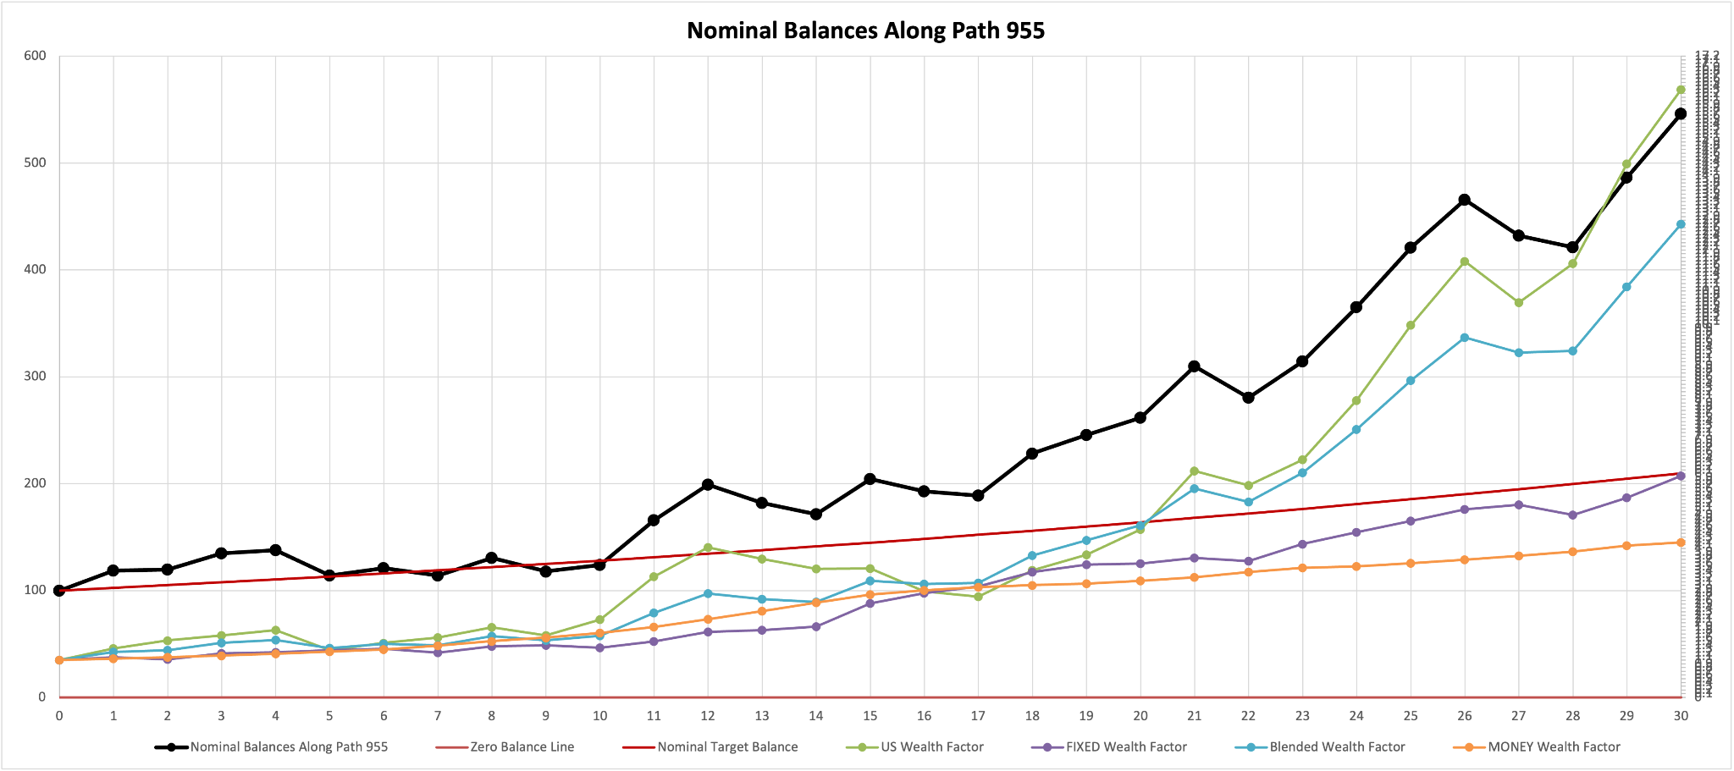
55/-30/75 Allocation
June
2025
25th percentile - Path 446
Higher volatility associated with higher return
Net 130% in equities and fixed income
75% in fixed income provides steady returns
Trading higher short-term volatility for better long-term returns and loss protection
75th percentile - Path 955
Notes:
Moira
Paths 497, 446

Slide 9
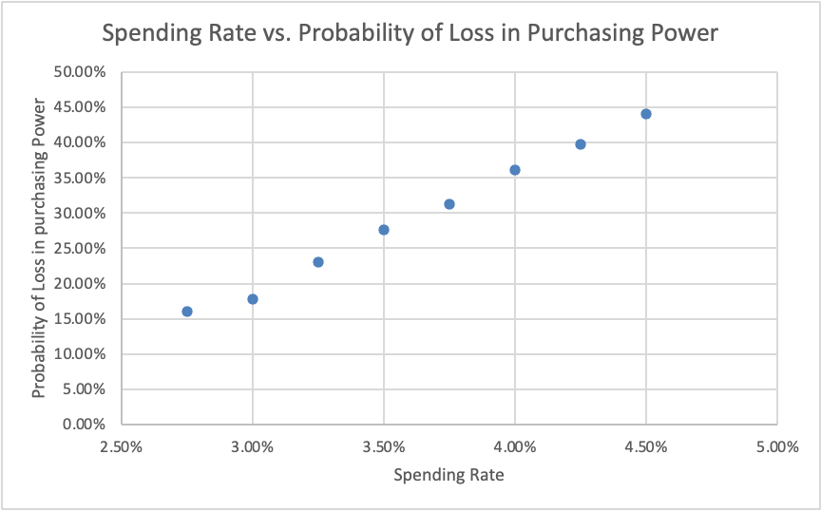
Spending Rate
June
2025
As stated previously, the fund has a target spending rate of 3% of its balance at the beginning of each year.
Our analysis suggests that an increase to this rate would likely work in opposition to the fund’s primary objective of preserving purchasing power over the next 30 years.
3% Spending
3.5% Spending
Probability of Loss of Purchasing Power | 17.8%
E[% Loss PP | Loss PP] | -26.43%
Real Balance ≥ 100 (Real Returns ≥ 0%) | 822
Real Balance Range | [25.54, 911.96]
Average Real Return | 1.73%
Median Real Return | 1.77%
Probability of Loss of Purchasing Power | 27.6%
E[% Loss PP | Loss PP] | -26.30%
Real Balance ≥ 100 (Real Returns ≥ 0%) | 724
Real Balance Range | [21.89, 795.17]
Average Real Return | 1.24%
Median Real Return | 1.28%

Slide 10
30-Year Investment Allocations
Recommended Strategy
Alternate Strategy
62/2.5/35.5
55/-30/75
Large Cap / Money Market / Fixed
Large Cap / Money Market / Fixed
Comparison with Historical 60/0/40 Investment Strategy
Increase
Comparable
0.3% or 2.3%
June
2025
Legacy Portfolio
3% Spending Rate
2.5% Annual Inflation
Minimal Increase of E[% Loss PP | Loss PP]
Information is based on simulated data from AIRG Economic Scenario Generator
Purchasing Power Risk: 17.8%
Purchasing Power Risk: 15.8%
Decrease
Median Return
Volatility
Purchasing Power Risk

Slide 11
Thank You!
June
2025
Albert Chui, Aarti Garaye, Moira Keating, Jack Trujillo
Open for questions

